Slide 1

Research Methods
Black Swans, trusting Turkeys and Rabbitducks
Prof. Dr. Katrin Stefan

Slide 2
Task: Applying the IMRaD-Scheme
Please create a one-pager draft as a first rough exposé on your preliminary topic.
To do this, use the three instructions for the IMRaD scheme provided in Moodle.
We will discuss your individual approaches in July.
State of the art
Knowledge gap
Research Question
Method
Results
Discussion

Slide 3
Research Methods
The Philosophy Day - What actually is "scientific"?
The Structure Day - Structure and methods of scientific work
The Statistics Day - How did they measure it? Operationalizing and scale etc.
The Data Day - Practice - statistical evaluations with data sets

Slide 4
Statistics Day
How did they measure that?
Methods
Samples, normal distribution and black swans
Butterprezels cause obesity – research design
Skale levels und Operationalisation

Slide 5
How did they measure that?

Slide 6


Slide 7
Excercise: Understanding Study Design
Advertising with "Scientifically proven" -
Questions:
What exactly was examined?
What was the question?
How many subjects were involved?
What was compared?
Sketch the test procedure!
What could be problematic about that?

Slide 8
How did they measure that?
And why does it matter?
The population is becoming more and more polarized
The rich are becoming richer, the poor poorer
People are lonelier than their grandparents

Slide 9
Hypotheses
Falsifiable
Describe connections
If-then + so-so

Slide 10
Statistical Hypotheses
Intensification of a substantive hypothesis to an empirical prediction of the research result
Assumptions about the distribution of random variables
Probability statements
Source (translated): Handerer, Joshua; ttps://docplayer.org/7583203-Forschungsmethoden-von-josua-handerer-kontakt-josua-handerer-t-online-de.html, abgerufen 2.5.2020

Slide 11
Scientific Hypotheses
Criteria for a scientific hypothesis:
A scientific hypothesis is a general assertion (universal sentence) that goes beyond the individual case or a singular event
A hypothesis must at least implicitly be based on the formal structure of a meaningful conditional sentence (“if-then sentence”, “so-so-sentence”).
The conditional clause must be potentially falsifiable. That is, events must be conceivable that contradict the conditional clause.

Slide 12
Structure of a scientific work
  Topic
  State of the art
  Knowledge gap
  Research Question
  Method
  Results
  Discussion
  Outlook
I
M
R
D

Slide 13
Structure of a scientific work
  Topic – field, discipline (not: company has no experience with…)
  State of the art: Narrowing down topic based on literature research
  Identifying a Knowledge gap: there is very little evidence …
  Research Question: Knowledge gap as a question
  Hypotheses: Question inverted into a sentence (or sentences) which can be falsified, so they are either true or not (supported or rejecected)
  Method
  Operationalization – how could this be put into a form that can be measured
  Carrying out the investigation – gathering primary or secondary data
  Data Processing
  Results
  Hypotheses supported or rejected
  Discussion – what is conform with other authors, what is surprizing, potential reasons
  Limitations – time and money, sample size, lag of representativeness
  Outlook – what remains unclear, where is more research needed
I
M
R
D

Slide 14
Research Design
Single Case
Aggregated Analysis of Cases
Survey
Census
Sample sizes as a continuum:

Slide 15
Methods
Single case analysis – Case Study
Aggregated analysis of cases – e.g. Expert Interviews
Survey – Representative Sample
  Longitudinal Studies/Panels
  Cross-sectional Studies
  Metaanalysis

Slide 16
TOOL | BEST FOR | PRICE | SKILL LEVEL
ChatGPT (Code Interpreter) | General stats + homework help | Free / $20/mo | Beginner-Advanced
Julius AI | No-code data analysis | Free / $20/mo | Beginner
Statsig | A/B testing and experimentation | Free tier / Custom | Intermediate
IBM SPSS v31 | Enterprise and academic research | $99/mo+ | Advanced
Jamovi | Free statistical software | Free (open source) | Beginner-Intermediate
R + AI copilots | Advanced statistical modeling | Free (open source) | Advanced
Python + AI assistants | Statistics combined with automation | Free (open source) | Intermediate-Advanced

Slide 17
Excercise: Getting to know methods
Please work out the assigned topics and present them in the afternoon
Where to find data? List of specialist databases
Qualitative research methods: Advantages and disadvantages
Quantitative research methods: Advantages and disadvantages
Longitudinal studies - Cross-sectional studies - Meta-analyses
Questionnaire design – what needs to be considered?
Structured Interviews – What should be considered?
Case Study – Importance and Representativeness

Slide 18
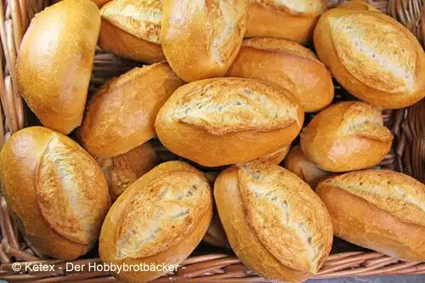
https://dai.ly/x2or8pw

Slide 19

https://www.youtube.com/watch?v=3m4bxse2JEQ

Slide 20
Normal Distribution
The majority of random events in the world are normally distributed
Therefore, from a sufficiently large sample, it is assumed that the events are normally distributed (there are also other distributions)

Slide 21
https://www.simplypsychology.org/normal-distribution.html

Slide 22
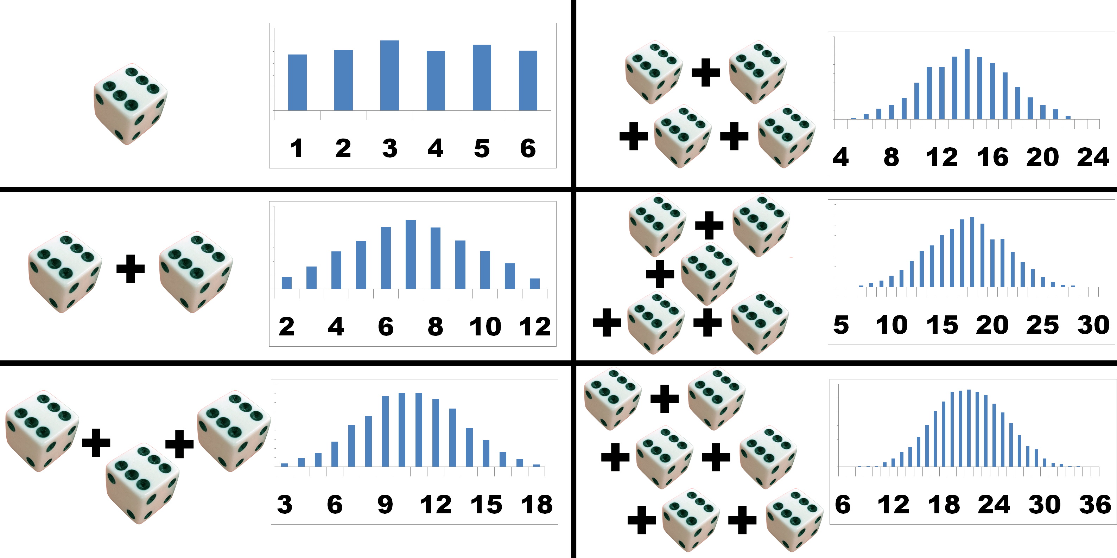
Central Limit Theorem
https://www.investopedia.com/terms/c/
The central limit theorem states that the distribution of sample means approximates a normal distribution as the sample size gets larger, regardless of the population's distribution.

Slide 23
Central Limit Theorem
For practical reasons we might assume, that the distributipn of means is sufficient normal if
n >= 30
Source (translated): Bortz, Statistik, Heidelberg, 2005, S. 97

Slide 24
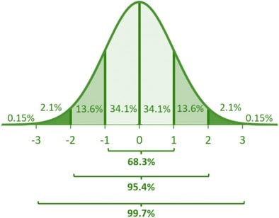
When is the assumption of normal distribution problematic?
Roughly explained, the normal distribution states that a large deviation from the average deviation from a course is extremely rare
But: There are Black Swans!

Slide 25
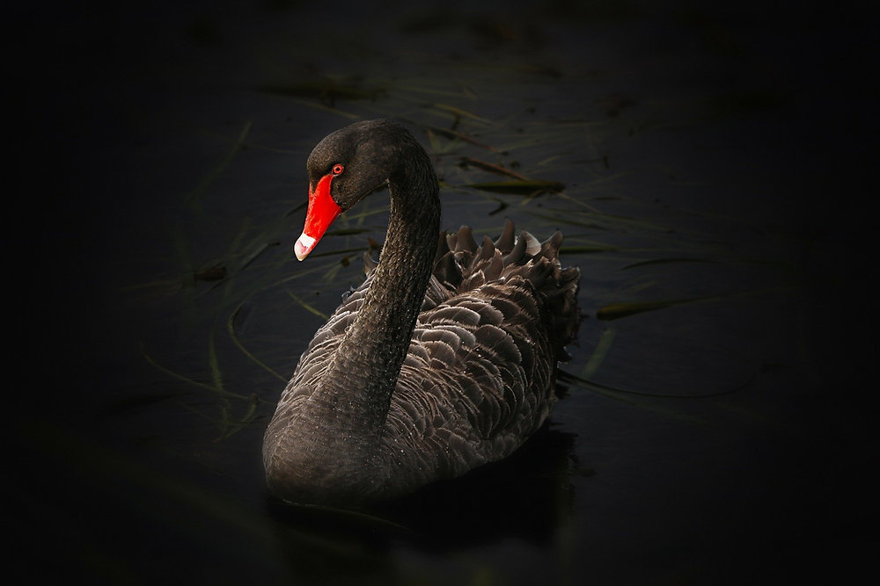
Black Swan
https://www.youtube.com/watch?v=BDbuJtAiABA

Slide 26
#kapierstau

Slide 27
Types of variables in investigations to clarify if-then relationships
Dependent variable Variables whose dependency on the independent variables is examined
Independent variable Their influence on the dependent variable is to be examined; they are varied (more or less) according to plan by the experimenter
Control variables Are also surveyed because they could possibly have an influence on the dependent variable
Random variables Any variables that otherwise have an impact on the dependent variable but have been overlooked

Slide 28
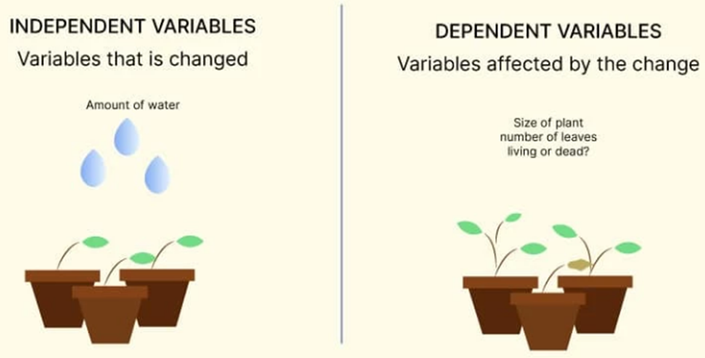

Slide 29
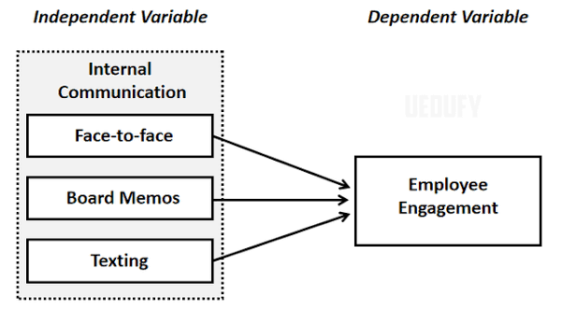

Slide 30
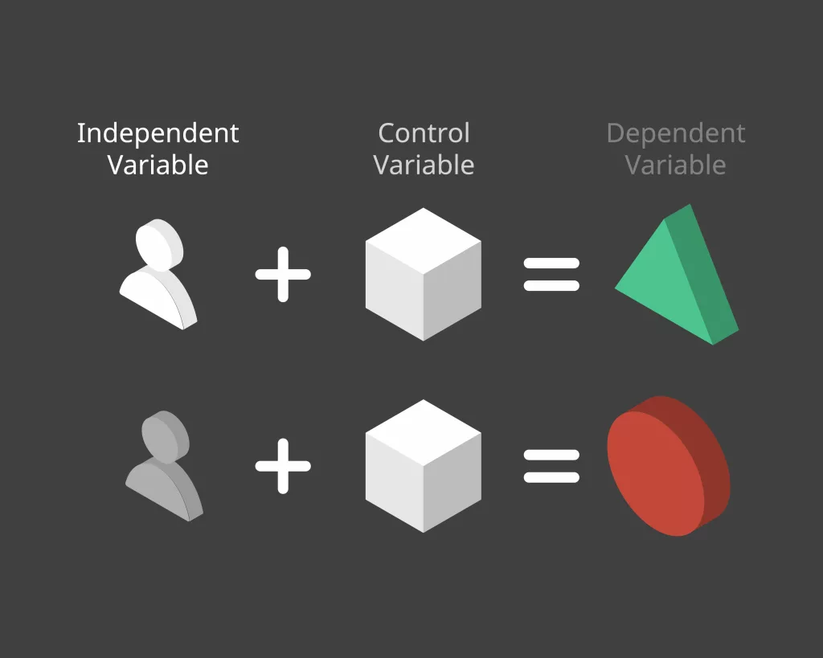

Slide 31

Example: Types of Variables
Hypothesis: Buttered pretzels make you fat - The more buttered pretzels a person eats, the more they weigh
Dependent variable: body weight
Independent variable(s): Amount of pretzel consumption in one year
Control variables: age, gender, socioeconomic status, diseases
Random variables: not collected, but reduce the accuracy of the explanation

Slide 32
Example: Types of Variables
Hypothesis: The older a person, the more likely they are to die of Corona
Dependent variable: Death from Corona
Independent variable(s): age
Control variables: gender, medical history, obesity
Random variables: not collected, but reduce the accuracy of the explanation
Result: Statistically significant connection between age and death from Corona; the probability of dying from Corona increases with age; But that doesn't mean that children can't die from it, too

Slide 33
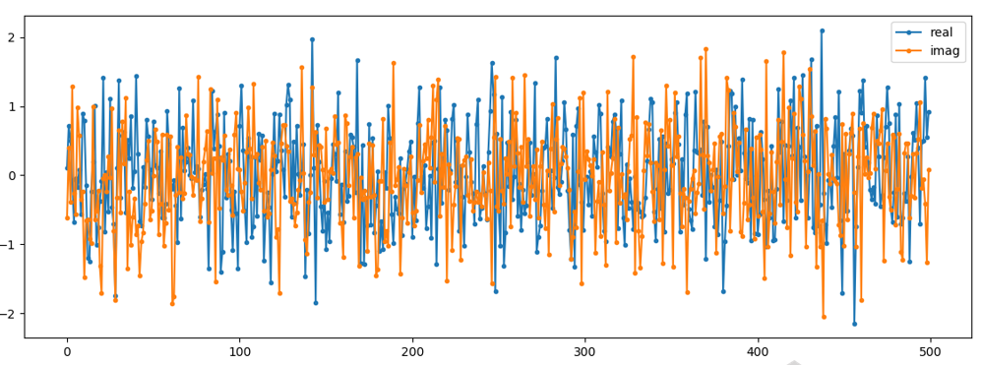
Random Variables in experimental Designs
Influence of time (between Pre- and Post-Test)
Maturation- and Learning Processes
Testeffects
Change of measuring instruments
Missings
Statististic Regression

Slide 34
Task: Different kinds of Variables
Please consider a test context for your research question
Hypotheses:
Dependent Variable:
Independent Variable(s):
  Control Variables:
Random Variables (noise):

Slide 35
How could you measure that? - Operationalization

Slide 36
Task:
How could we measure that?
Success
Employee satisfaction
Organisational culture
Innovation degree
Creativity

Slide 37
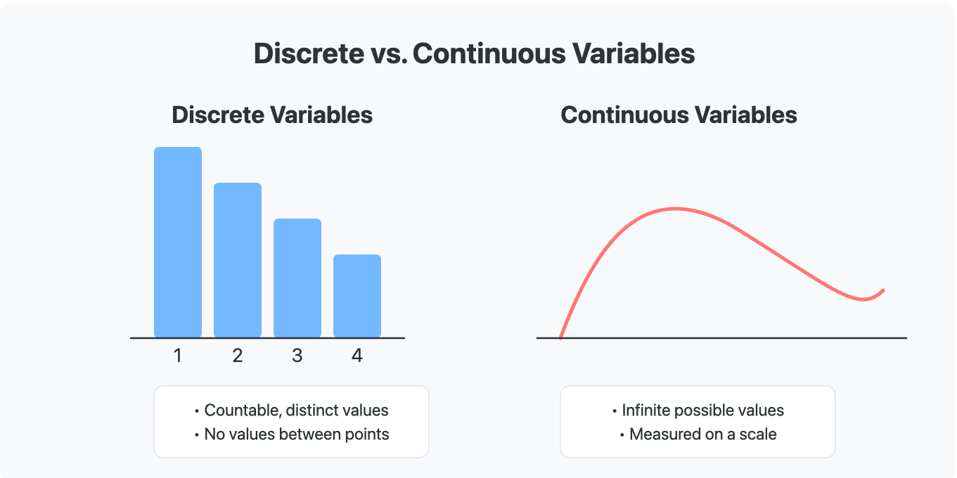
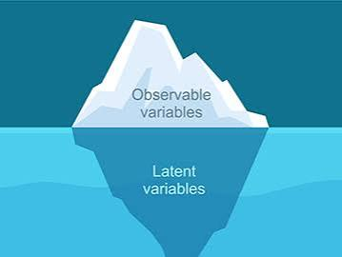
Characteristics of Variables
Steady - Without a break - Size
Discrete - Intermittent - Number of children in a family
Manifest - directly measurable - shoe size
Latent - not directly measurable - working atmosphere

Slide 38
https://www.voxco.com/blog/measurement-scales/

Slide 39
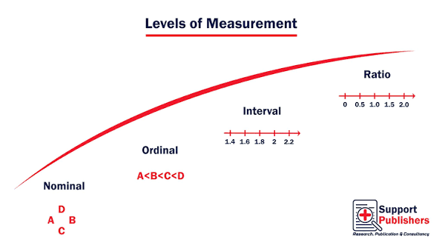

Slide 40
Levels of Scale
Nominal scale | no "natural order" in the sense of bigger-smaller, better-worse Is the same/is not the same | Gender, Colours, Car brands, marital status | female - male, red - green - blue - yellow, BMW - VW, single - married - divorced
Ordinal scale | larger-smaller, better-worse, but the distances between the values ​​are not equal Kategories/classes | Ratings, grades; Rankings | never - seldom - sometimes - often - always, very good - good - satisfactory - sufficient - insufficient - insufficient Up to 12 years / 13 to 15 years inclusive; 16 years and older The world champion is not three times as good as the third best
Intervall scale | larger-smaller, better-worse, and the distances between the values ​​are the same | Temperatur in Celsius degree | 21 degrees Celsius - minus 12 degrees Celsius (there is no natural zero point!)
Ratio Scale | an interval scale with a "natural" zero point | Body weight, distance, age, income | 56 kg - 112 kg (there is a natural zero; therefore 112 kg is twice 56 kg!)

Slide 41
Levels of scale
Important for the questionnaire: With a higher level of the scale I can do everything that I can do with a lower level of the scale, but not vice versa

Slide 42
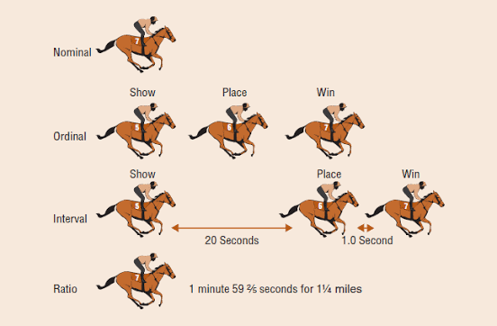
Source: https://itfeature.com/statistics/level-of-measurements

Slide 43
Why is the level of scale important?
Nonmetric/
categorical
Nominal scale
Ordinal scale
Non parametric tests
(Median; Spearmans‘ Rank correlation coefficient; Chi-Square-Test)
Parametric Tests
(Assumption Normal distribution)
Arithmetic mean t-tests, KQ-Regression
Metric
Intervall scale
Ratio scale

Slide 44
My Miserable Week in the ‘Happiest Country on Earth’
For eight years running, Finland has topped the World Happiness Report — but what exactly does it measure?
https://www.nytimes.com/2025/05/02/magazine/finland-happiest-country.html

Slide 45
Cantril Ladder
https://www.researchgate.net/publication/41403889_Self-reported_physical_and_mental_health_status_and_quality_of_life_in_adolescents_A_latent_variable_mediation_model

Slide 46
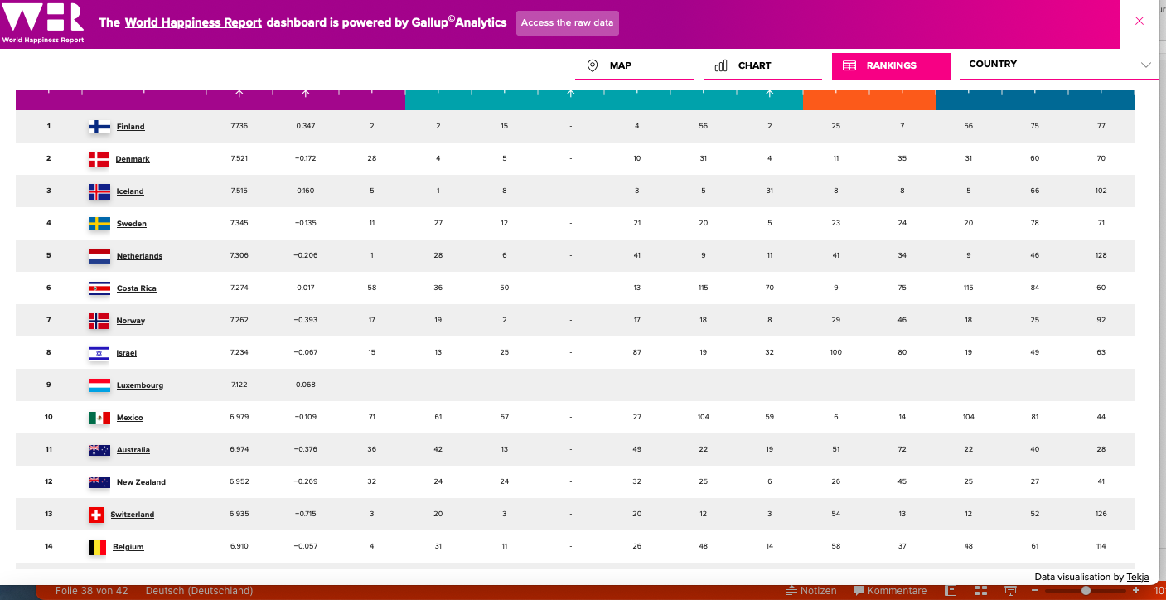

Slide 47
https://data.worldhappiness.report/map

Slide 48
What happens if the scale level doesn't match the test?
Ideally, the measuring method should match the scale level
Higher level of scale required (e.g. ordinal scale with regression) standard error underestimated and false positive error higher
Lower scale level required for test (less information, more false negative errors) Nominal Variables with Interval
Measurement Method - Nonsensical Results (Mean of Green and Blue)
Ordinal scale treated as an interval scale is common in social sciences

Slide 49
Numeric Rating Scales
Example Likert-Scale
Actually ordinal-scaled, but often interpreted as interval-scaled if at least 5-7 items
Equidistance assumed
Discussion Unipolar/Bipolar (Even/Odd; gerade ungerade)

Slide 50
Test of Significance
H1 Alternative hypothesis: There is a connection (e.g. tiredness reduces concentration)
H0 null hypothesis: There is no connection (fatigue has no effect on concentration)
Result relevant if the null hypothesis is rejected p < 0.05 sig, H1 is (tentatively) confirmed

Slide 51
Operationalization and questionnaire design
Consider evaluation options (e.g. crossing of variables)
Open versus closed questions (words and numbers)
Consider later operationalization options/classes
Even or odd scales
"I don't know" category

