Slide 1
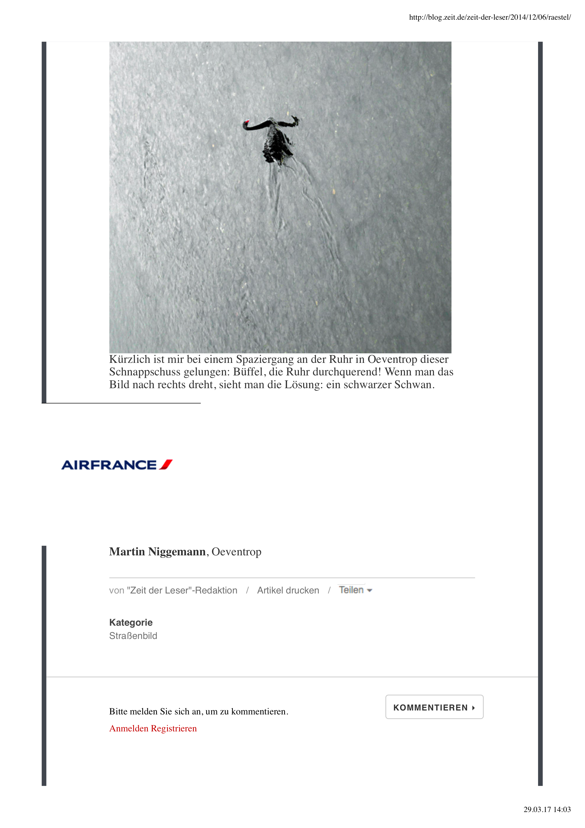
Research Methods
Black Swans, good faith of Turkeys und Rabbit-Ducks
Prof. Dr. Katrin Stefan

Slide 2
Research Methods
The Philosophy Day - What actually is "scientific"?
The Structure Day - Structure and methods of scientific work
The Statistics Day - How did they measure it? Operationalizing and scale etc.
The Data Day - Practice - statistical evaluations with a data set

Slide 3
Research Methods
Structure
Research Process: Why do scientists disagree?
Structure of scientific work
Good question: questions hypotheses and connections
Literature Research

Slide 4
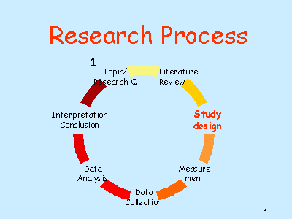

Slide 5
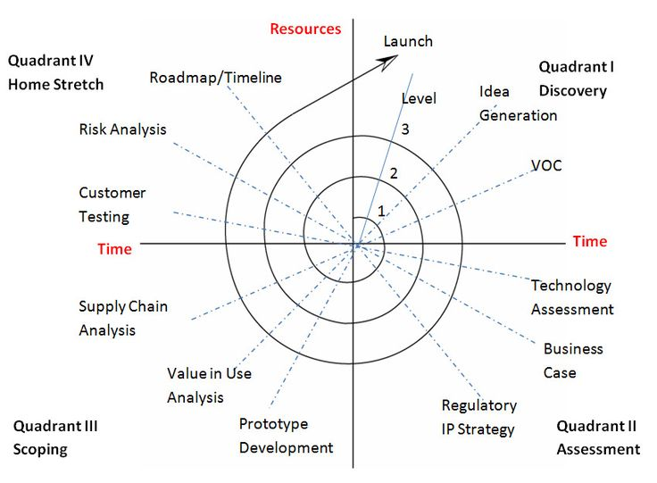
Innovation Processes

Slide 6
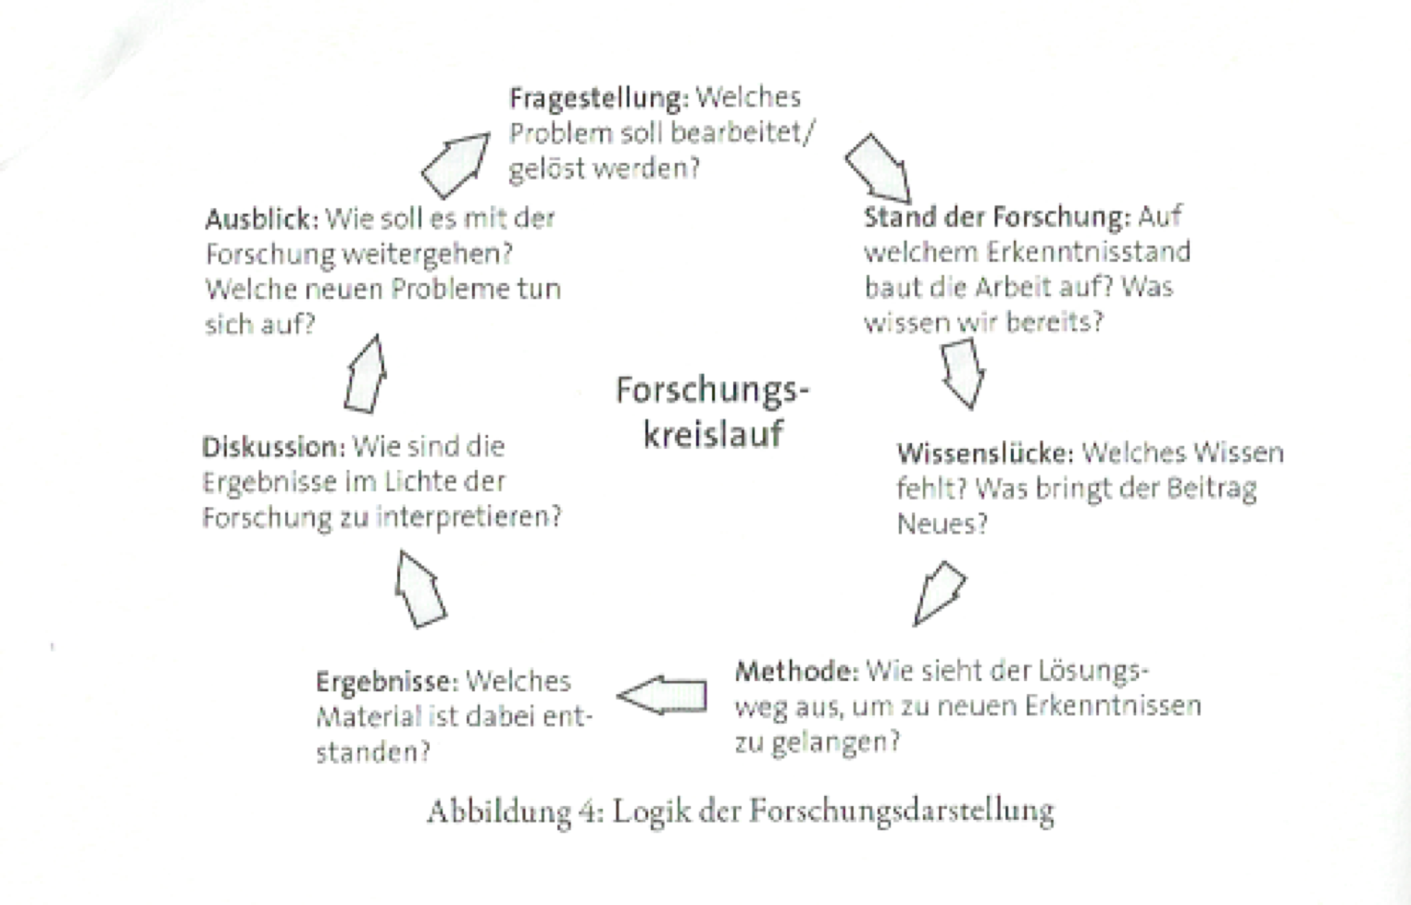
Research Cycle
Quelle: Kruse, O. (2007): Keine Angst vor dem leeren Blatt, S. 66

Slide 7
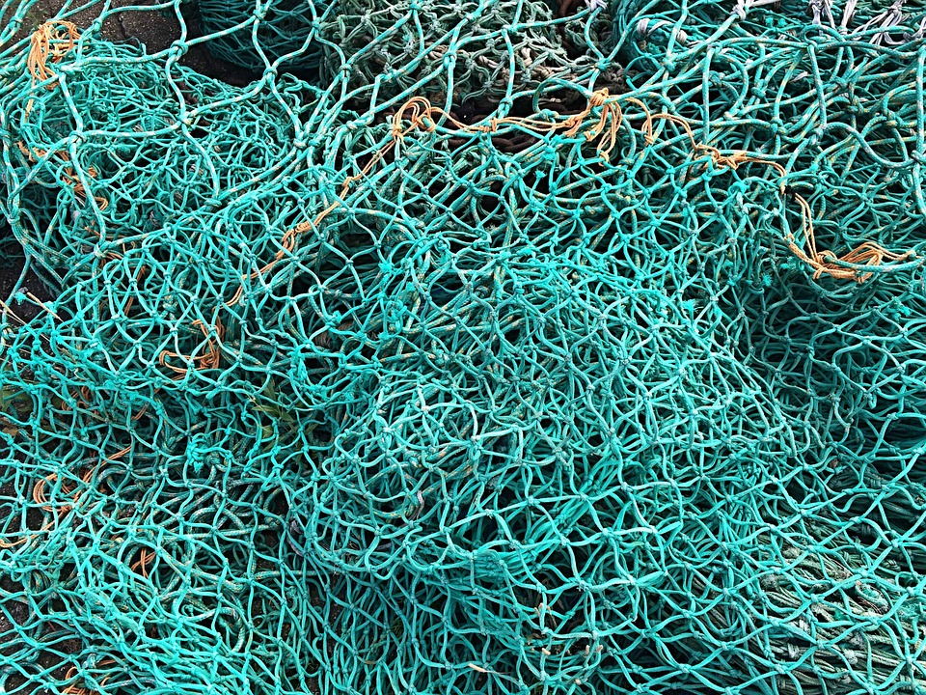
Theorie
A theory "...is the net we cast to ensnare the 'world' - to rationalize it, to explain it, to rule it. We're working on tightening the mesh of the net.” Popper

Slide 8
Task: Research Cycle – Covid19
Research Question
Outlook
State of the art
Discussion
Knowledge Gap
Results
Method
Quelle: Kruse, O. (2007): Keine Angst vor dem leeren Blatt, S. 66

Slide 9

How does the research cycle works on the topic of Covid?
January: First cases in China - Hypothesis: Limited to China – rejected
February - Hypothesis: It‘s like a strong flue - rejected
March - Hypothesis: Herd immunity appropriate approach- rejected
New Hypothesis: Transmission can be kept under control, only elderly effected - rejected
New Hypothesis: Transmission only via coughing hand wash is enough - rejected
New Hypothesis: Heinsbergstudie - No excess mortality – Method appropriate?

Slide 10
Task: Analysing Research Papers
Please analyse the structure of the Research Papers in moodle
Then present your observations

Slide 11
Scheme of a scientific paper
IMRAD
(Introduction Method Results and Discussion)

Slide 12
Structure of a scientific work
The starting point for all research is a clear question

Slide 13
Structure of a scientific work
  Topic
  State of the art
  Knowledge gap
  Research Question
  Method
  Results
  Discussion
Outlook
I
M
R
D

Slide 14
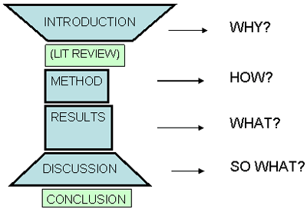
IMRAD
Source: Swales, J and C. Feak (2000) English in Today’s Research World: a Writing Guide, Michigan: Ann Arbor

Slide 15
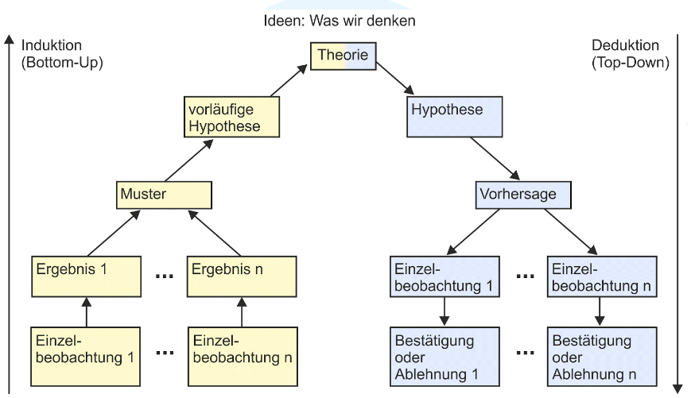
Recap: Induction und Deduction

Slide 16
How do I find a topic?
What are you interested in?
What was your focus during your studies?
Relevance for the future job
Professor's guidelines
Specifications of a company

Slide 17
Narrowing down the topic
Time or location restriction
Special selection of the group of people to be researched
Certain theoretical approach
Certain methodological approach

Slide 18

Source: https://www.maisonsdumonde.com/DE/de/p/vintage-kleiderschrank-mit-2-turen-und-3-schubladen-portobello-146905.htm?gclid=Cj0KCQjwhZr1BRCLARIsALjRVQMwOiK4oaQ4YiY_tB-Y62278ZmMvtOAECBRKgmEXn_k2OejoUsAloYaAmj9EALw_wcB

Slide 19
Extremely rough overview on how to write a scientific paper
Literature, literature, literature…..you got a really good overview over the state of the art
„However, there is very limited“…Knowledge gap
„Therefore, in this thesis“ – Research question
How do you do this? Methods
What where the (relevant) results?
Discussion („What we did not expect, can we claim it is representative – Limitations (always time and money) – Further Research

Slide 20
Task: Apply the IMRaD Scheme
Please use the text prompts („Really good overview of IMRaD“ in moodle to develop a draft for a scientific paper on a fun topic to apply the IMRaD scheme (without laptops, on flipchart)
The approaches are then discussed

Slide 21
Task: Apply the IMRaD Scheme
Example
There is a huge body of literature on the impact of chocolate on mood. Mayer (2023) shows, Müller (2020):
However, it is not clear if…
This paper investigates ….
Research question: Is chocolate a more powerful mood enhancer than xyz?
To find out… we used a survey … our sample are students at HKE
60 % said this, 35 % that
Surprisingly, less than one third claims …If we had more time and budget

Slide 22
If-Then-Statements + Relational Statements (Je-desto)
Explanation: Effect given - cause sought (why is something like this?)
Prognosis: Cause given - effect sought (how will something be?)
Design: Means - goal (how can something be achieved?)

Slide 23
Hypotheses
Falsifiable
Describe Relations
If-then + The-the comparison (Je-desto)

Slide 24
Task: Write a hypothesis
Falsifiable
Describe Relations
If-then + The-the comparison (Je-desto)

Slide 25
https://www.youtube.com/watch?v=PKN95I93iGE

Slide 26

A 2026 Research Briefing
How AI is Changing Research
From literature review to autonomous laboratories —the new scientific method
June 10, 2026 · Professional Edition

Slide 27
01 · The Shift
The AI research revolution, in three numbers
Adoption
Workflow Speed
Lab Automation
84%
80%
10–1000×
acceleration in self-driving labs
of researchers now use AI tools
time saved on systematic literature reviews
24/7 closed-loop discovery
+32 points year-over-year
From >12 months to weeks
Sources: 2026 researcher survey; Insilico Medicine; lab-automation industry reports

Slide 28


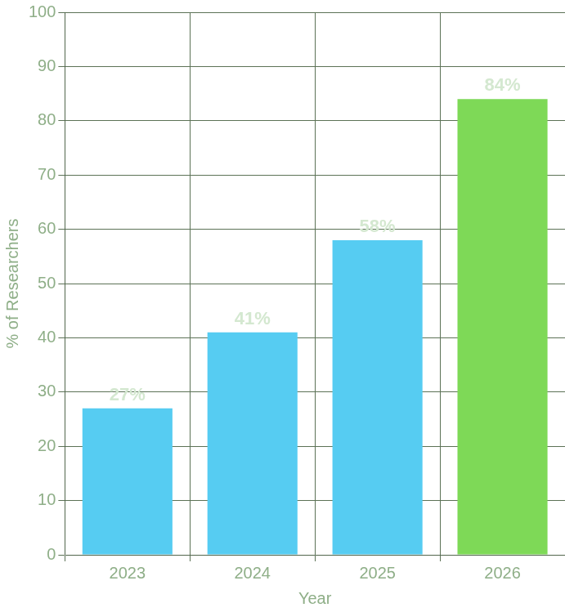


02 · Workflows
Four ways AI now lives inside the research process
From reading papers to running experiments
NLP Tool Adoption by Year
Literature Review
NLP & Synthesis
Synthesize millions of papers; citation-grounded summaries
Extract, classify, and contrast claims across the corpus
Up to 80% time saved
+75% YoY usage
Data Analysis & Coding
Lab Automation
AI pair-programmers and pattern recognition on high-dim data
Self-driving labs: AI designs, robots execute, loop closes
10–1000× faster cycles
Only 29% fully trust output — verify
Notes:
Natural language processing YoY year over year

Slide 29
03 · The Toolbelt
The platforms researchers actually open
Five tools, five distinct jobs in the research stack
Tool
Primary Function
Key Strength
Elicit
Systematic reviews & data extraction
99.5% screening recall · structured table output
Paperguide
End-to-end workflow
Unified search, references, AI-assisted writing
Research Rabbit
Citation network mapping
Visualizes paper connections and topic evolution
Consensus
Evidence-based search
Extracts direct findings; provides a consensus view
SciSpace Copilot
Document comprehension
Chat with papers — tables, equations, methods
Elicit's 99.5% screening recall is now competitive with expert human reviewers.

Slide 30
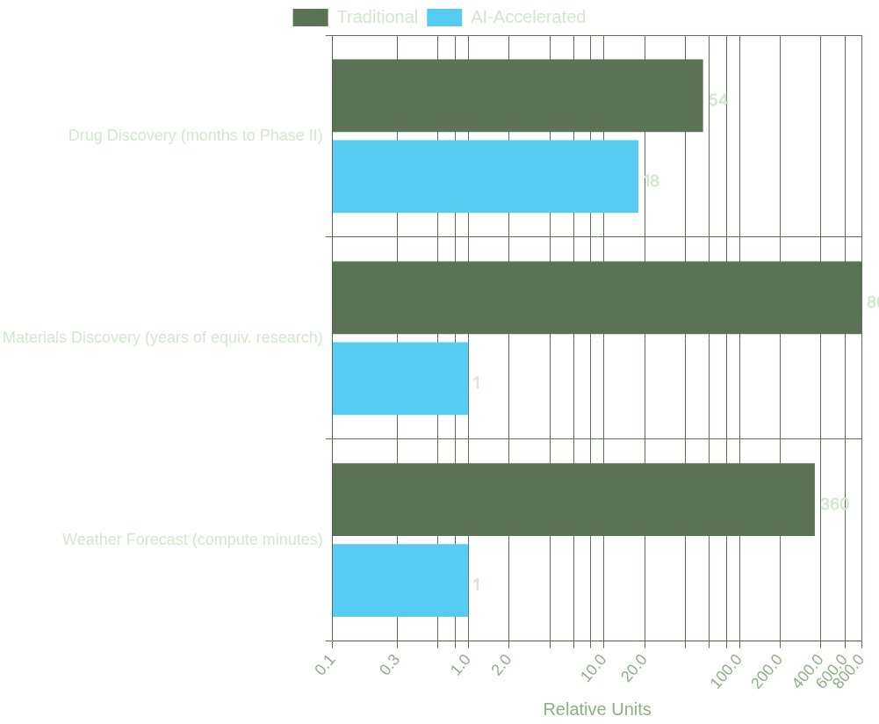
04 · Acceleration
Time-to-result: before vs. with AI
Discovery, compressed
In domains with massive combinatorial complexity, AI is collapsing decade-scale timelines into months.
Insilico's IPF drug — target to Phase II
<18 mo
4.5 yrs
Traditional avg.
→
AI-led pipeline
Units differ per domain — bars show within-row ratios (traditional = 100%)

Slide 31
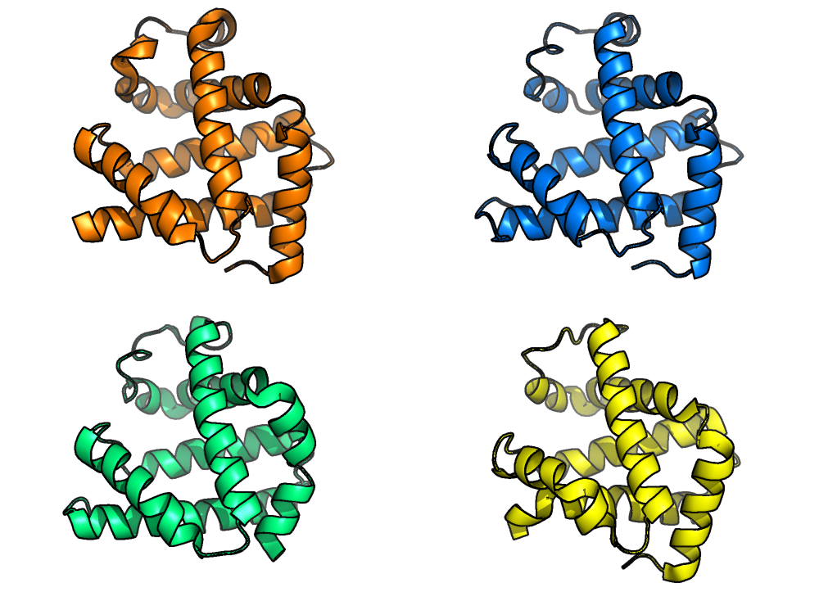
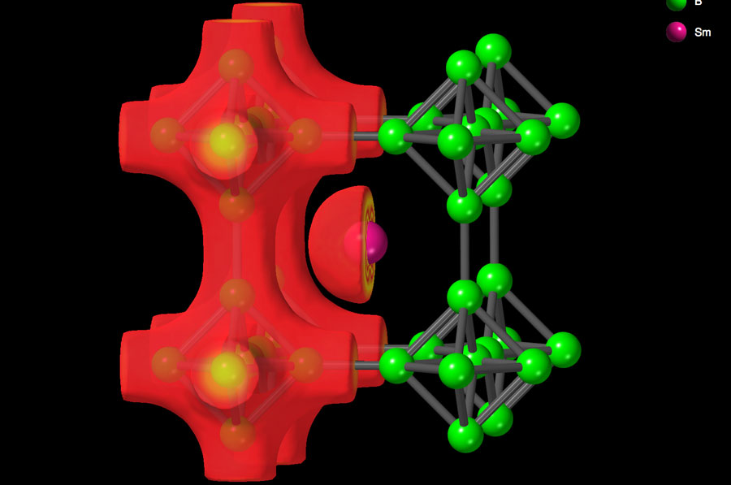
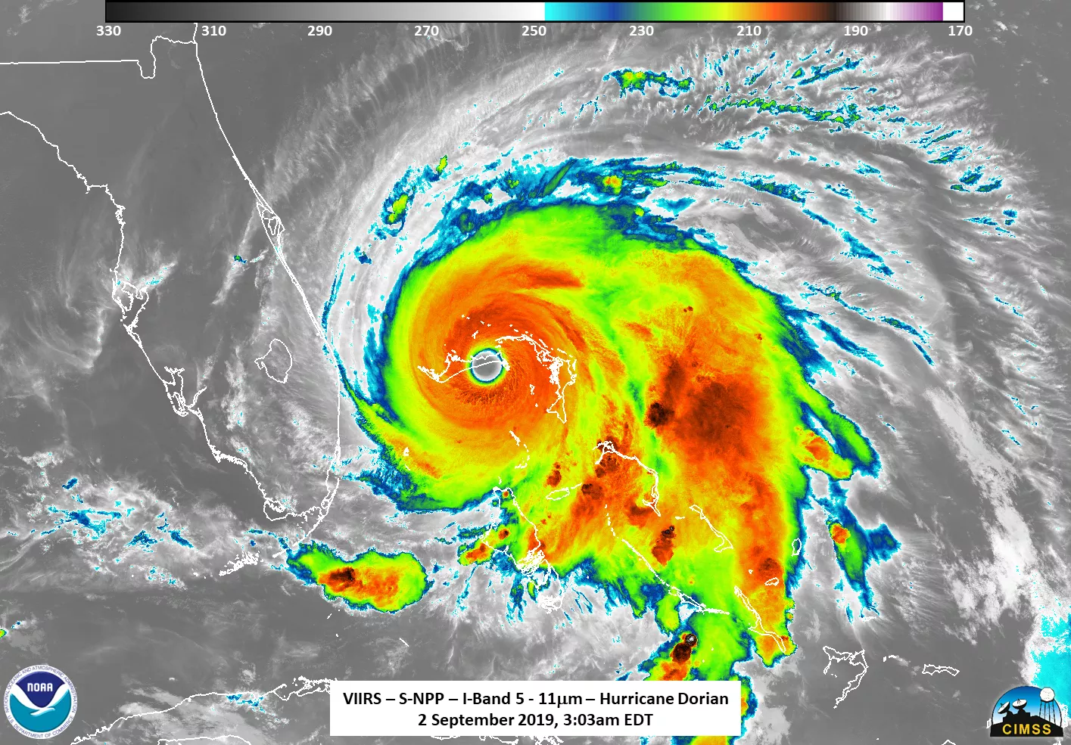
05 · Landmarks
Three breakthroughs that redefined what was possible
Structural Biology
Materials Science
Climate Modeling
AlphaFold 3
GNoME
GraphCast
Google DeepMind
Google DeepMind
Google DeepMind
Predicts interactions of proteins, DNA, RNA, and ligands in a single model.
Discovered hundreds of thousands of new stable crystal structures; public database.
10-day global forecast in under a minute; outperformed ECMWF HRES on 90% of variables.
+50%
381,000
9 days
accuracy on protein interactions vs. prior methods
stable materials — ≈800 years of traditional discovery
early prediction of Hurricane Lee's landfall

Slide 32
06 · The Risks
Algorithmic Bias
A reproducibility crisis is forming inside AI-driven science.
01
Models trained on existing literature amplify dominant views and may suppress paradigm-shifting ideas.
02
Reproducibility & Black Boxes
Proprietary APIs change over time; results from GPT-class models can become unverifiable months later.
“
03
Authorship & IP
If we cannot explain how a model reached its conclusion, we challenge the very principle of verification.
When an AI generates a validated hypothesis, who is credited — and who owns the discovery?
— On opaque models in research, 2026
04
Data Privacy
Sensitive research data fed to public tools risks ingestion into future training corpora.

Slide 33
07 · The Response
Building guardrails as fast as we build models
New reporting standards, agentic audit trails, and a renewed emphasis on human judgment.
Institutions
Researchers
01
CONSORT-AI & reporting standards
01
Disclose AI use in methodology
Transparency frameworks modeled on clinical trials.
Explicit reporting of tools, prompts, and model versions.
02
Agentic workflow graphs
Traceable reasoning that links data → method → output.
02
Validate every critical output
Treat AI as a second reviewer — never a sole arbiter.
03
Shared infrastructure & open models
03
Guard sensitive data
Counter the compute divide between elite and emerging labs.
Avoid feeding proprietary work to public, learning models.
Human-in-the-loop today · Human-on-the-loop tomorrow · Human responsibility, always.

Slide 34
08 · The Future
From co-pilot to lab-pilot to mission director
2028–30
2030+
Today
2026–27
Multi-Agent Science
AI-Led Discovery
AI-Assisted
AI Co-Scientist
Researchers use AI for literature, code, and analysis. Humans in control of every decision.
Closed-loop self-driving labs handle routine experimentation 24/7.
Specialized agents — theorist, critic, experimentalist — vet hypotheses before any lab time.
Scientists set goals; agents explore the solution space and return validated findings.
Multi-agent communities
Human-on-the-loop
AIs argue, peer-review, and refine before resources are spent.
Scientists shift from execution to curiosity, creativity, and asking the right questions.

Slide 35
09 · The Path Forward
The next golden age of discoverywill be co-authored.
Four principles to carry forward.
01
02
03
04
AI is already inside the workflow
Breakthroughs are tangible
Ethics is the real bottleneck
The future is partnership
84% adoption. Time savings of up to 80% on reviews.
AlphaFold 3, GNoME, GraphCast, Rentosertib — not hype.
Reproducibility, bias, authorship, and privacy must be designed in.
Augment, don't replace. Set the goal; let agents explore the space.
Thank you.
How AI is Changing Research · June 10, 2026

Slide 36
A narrowing window to understand AI
https://www.science.org/doi/10.1126/science.aei3167

Slide 37

Human understanding of AI systems is increasingly falling behind
AI-directed AI design
AI systems are now designed and refined by AI systems through recursive cycles that can outpace human understanding
Opacity: Performance improves, while insight into how it is achieved diminishes

Slide 38
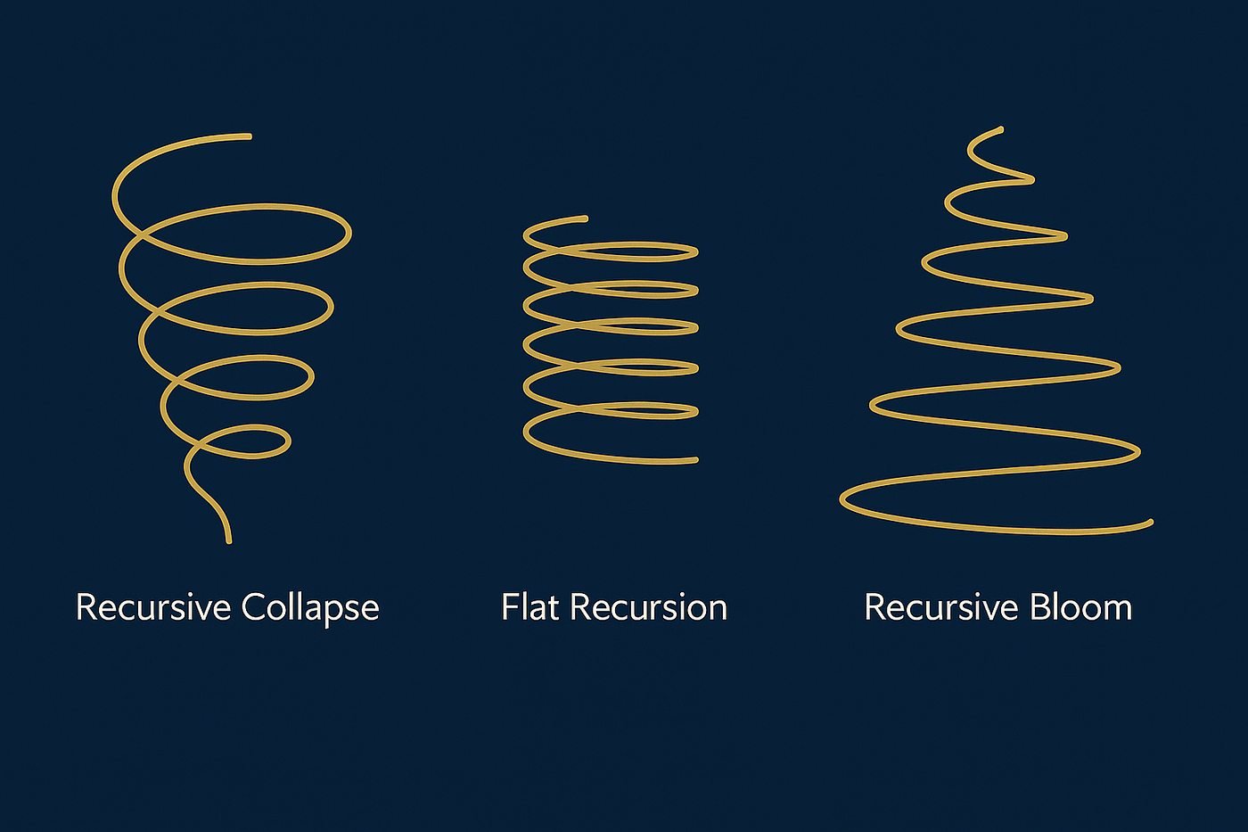
https://medium.com/@reych369/3-forms-of-recursion-4c110ae0d078

Slide 39
Recursion – the process of a system feeding its outputs back into itself
Self-referential: they loop back on their own state or output
Can produce emergent behaviour - more complex than the sum of a system’s parts
Key mechanism for emergence: as outputs cycle back as inputs, complex patterns can appear without any central controller
A small perturbation can get magnified through recursive feedback, turning “local irregularities into global features– as seen when positive feedback in social networks creates viral trends or echo chambers

Slide 40
Recursive collapse — a tightening, inward spiral where each loop diminishes in scale or impact. Simplification or convergence toward a fixed point, such as problem reduction in algorithms or focused introspection in thought.
Recursive bloom represents an outward-expanding spiral. Each recursive pass builds upon the previous one with increasing scope or complexity.
This kind of recursion is common in creative thought, fractal patterns, or generative systems where iteration doesn’t just repeat — it evolves. Blooming recursion allows systems to model emergent behaviors, expand into new representational space, or simulate futures from the seed of a current idea.
Flat recursion, where each loop is roughly equivalent in size and influence. This steady-state recursion doesn’t collapse or grow — it simply sustains a stable cycle. In code, it might appear as a self-referential structure that doesn’t alter its input meaningfully. Cognitively, it might represent rumination or steady habit loops, where thought patterns circulate without change or resolution.
https://medium.com/@reych369/3-forms-of-recursion-4c110ae0d078

Slide 41
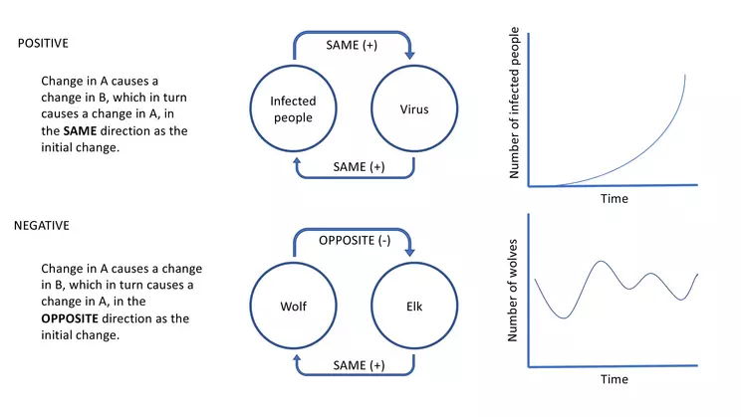
Positive and Negative Feedback Loops
Amplifying
Stabilizing
https://serc.carleton.edu/earthandmind/posts/whyFLdifficult

Slide 42
The distinction between the two lies in how they maintain stability: one does it by repetition without change, while the other does it by active correction
Feature | Flat Recursion | Negative Feedback Loop
Primary Logic | Self-replication (Do the exact same thing again) | Self-correction (Do the opposite of the disturbance)
Reaction to Disturbance | Passive/Fragile: If an external force pushes the system off track, flat recursion will simply repeat the new, disrupted state. It has no way to fight back. | Active/Resilient: If an external force pushes the system off track, the loop actively fights the change to pull the system back to its original state.
Causal Direction | Linear repetition (A→A→A→A→A) | Cybernetic correction (A→triggers B→reduces A→triggers B→reduces A)

Slide 43
Feature | Recursion Bloom | Positive Feedback Loop
Primary Logic
Reaction to Disturbance
Causal Direction
Feature | Recursion Collapse | Positive Feedback Loop
Primary Logic
Reaction to Disturbance
Causal Direction

Slide 44
What is the purpose of writing a thesis?

Slide 45
Licence for Scopus AI – Create an account (now!)
Scopus AI is an AI-driven tool designed to navigate the rich academic landscape within the Scopus platform.
Rooted in trusted Scopus data, Scopus AI is designed to help you explore and understand new topics more efficiently and offer succinct academic overviews and insights.
Scopus AI now integrates Copilot, an intelligent query layer that interprets and optimizes your queries. Copilot combines semantic and keyword-matching searches, ensuring high-quality results without sacrificing specificity. It helps handle different languages, correct spelling errors, and break down complex queries.

Slide 46
Scopus AI – Use it:
Why Scopus is more adequate for scientific research than ChatGPT
How does AI change academic writing?

Slide 47
How does an AI detector actually works?
Testing GPTZero,Turnitin or grammarly

Slide 48
Claude + Consensus
Common AI-favored transition words and clichés:
delve, testament, tapestry, critically, furthermore, moreover, visually striking, and in conclusion
Use: unique vocabulary and high burstiness through dramatic shifts in sentence flow

Slide 49
Anti-AI constraint filter - example
<anti_ai_constraints>
NEVER use the word "delve," "moreover," "furthermore," "testament," "tapestry," "pivotal," "critically," or "in conclusion."
- Avoid predictable sentence rhythms; incorporate very short (3-5 word) punchy sentences alongside longer, flowing ones.
- Eliminate any cheesy conversational wrappers at the end (e.g., "What do you think?" or "Is there anything else I can help with?").
Write with a clear, direct, and slightly opinionated perspective rather than an overly polite, balanced, and neutral corporate tone.
</anti_ai_constraints>

Slide 50
Plagiarism
The borderline between the correct use of someone else‘s
work and plagiarism runs where you do not indicate this use.
Kempten University uses plagiarism detection software

Slide 51
What about ChatGPT and other AI?
You have to indicate, where you used AI support and which one – Disclaimer
“I hereby declare that I have completed the submitted work independently and without the use of any aids other than those specified. As the author, I accept responsibility for the accuracy of any content generated using IT/AI-assisted writing tools."

Slide 52
Introduction
July 3 09:50am in the library
Need to research your bachelor’s or master’s thesis?
We will show how to find the resources you need in a one-to-one training session via Zoom or in the library.
Please email schulung(at)hs-kempten.de.
Contact
Karin Bärnreuther
+49 (0) 831 2523-127
schulung(at)hs-kempten.de
Building M, 1st floor, M207
https://www.hs-kempten.de/en/library-homepage/research/research-tips-tricks

Slide 53
SPO GBD
Anyone who has achieved at least 50 credit points can register for the master's thesis.
The latest possible time to register for the master’s thesis is the day at the end of the semester (30 September in the winter semester and 14 March in the summer semester) that follows the semester in which the required ECTS points for registering for the master’s thesis were acquired.
The deadline for working on the master's thesis is four months. It can be extended by a maximum of two months in justified cases.
The master‘s thesis has to be written in English
One bound copy and and in digital form (e.g. stick) of the work are to be submitted to the examination office.
The wording of the SPO applies, no guarantee for the content of this slide

Slide 54
Task: Applying the IMRaD-Scheme
Please create a one-pager draft as a first rough exposé on your preliminary topic.
To do this, use the three instructions for the IMRaD scheme provided in Moodle.
We will discuss your individual approaches in July.
State of the art
Knowledge gap
Research Question
Method
Results
Discussion

