Slide 1
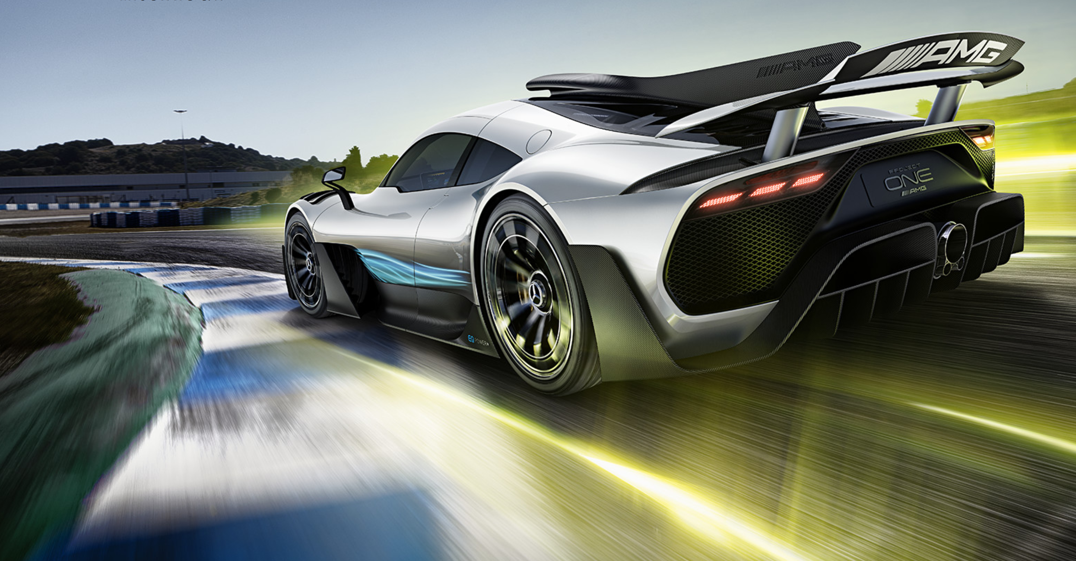
Fahrzeugkonzepte WS20
Gruppenarbeit
Vorlage für Gruppenarbeit (hier den Titel)
Gruppenmitglieder
Notes:
Many thanks - It is a pleasure for me once again to give a presentation at the chassis.tech. Today I would like to raise a question that I am more often asked: What about digitalization as game changer? And do we still need good vehicle dynamics in the future?

