Slide 1
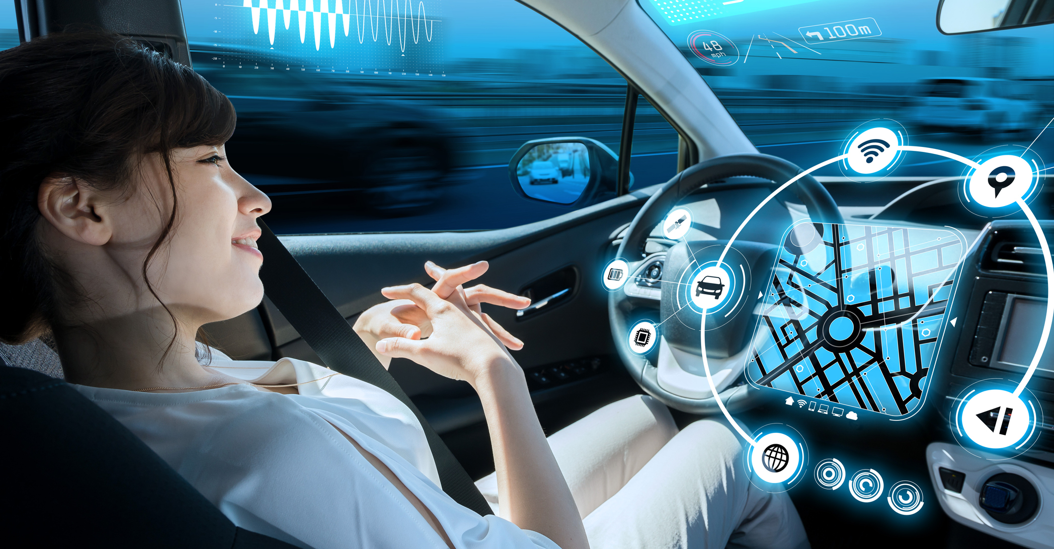
Automated driving is becoming increasingly important and will shape the future of mobility.
Research for Automated Driving
Kempten University of Applied Sciences | Germany

